Slide 1

PowerPoint Presentation
Personal Phonebook & Tower of Hanoi
Kemayah Noel & Giovanni Thompson

Slide 2

We Would look at the Personal Phonebook first

Slide 3

We found this idea by looking at things that could make things easier for us
Well this project has just that
Wouldn’t you like to see whose number you are dialing or have a digital version of your phonebook
You can Sort the saved contacts from Ascending or Descending Order
You can also sort it by letters

Slide 4

Sorting
Searching
The Phonebook has three functions
Listing

Slide 5

Personal Phonebook
Uses time sort which is a combination of merge sort and insertion sort
We used it because it is a stable sorting method and because of its sorting abilities.
The complexity of the sorting are:
Best = O(n)
The sorting part is handled by the JS file called phone.js which is an external JavaScript file
It has an excellent performance on partially sorted data.
Average = O(n log n)
Worst = O(n log n)

Slide 6

1
2
The Alphabetical filter was setup and made in the JS file under the heading ALPHABET FILTER
All functions are labeled in JAVAscript file

Slide 7
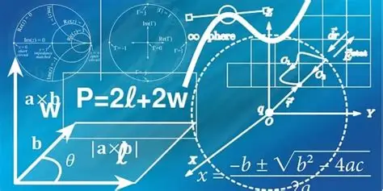
The Complexities of the Personal Phonebook
Time Complexity
Space Complexity
Searching = O (n)
Searching = 0 (1)
Sorting= O (n log n)
Sorting = 0 (n)
Alphabet Filtering = O (n)
Alphabet Filtering = 0 (1)
DOM Storage = 0 (n)

Slide 8
Now to look at the Tower of Hanoi

Slide 9
We got this idea from sir when he talked about it in class
Well this project has a message when you solve the Tower
We thought how about making our own for our final project and have everything it asks of us for our grade
It has different colors like the real deal and you can pick how many pieces you want from 3-7
It implements Drag and Drop

Slide 10
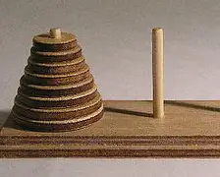
The Tower of Hanoi has Two Functions
Drag & Drop
JavaScript Call

Slide 11
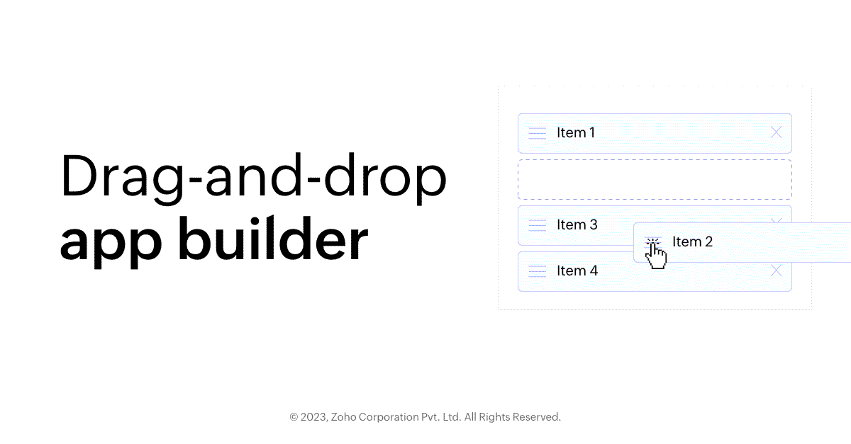

Has a call function where it calls it when you complete the tower of Hanoi to let you know you have completed it.
Used to drag the disks which are used to play the Tower of Hanoi.

Slide 12

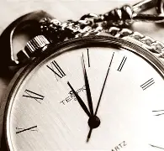
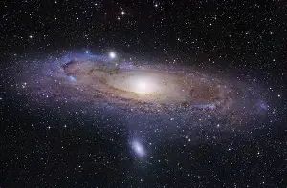
The Complexities
Space Complexity
Time Complexity
Setup Game = O (n)
Setup Game = O (n)
User Move = O (1)
User Move = O (1)
Theoretical Hanoi Algorithm = O (2n)
Theorical Hanoi Algorithm = O (1)

Slide 13

That’s all Thank You

Slide 14
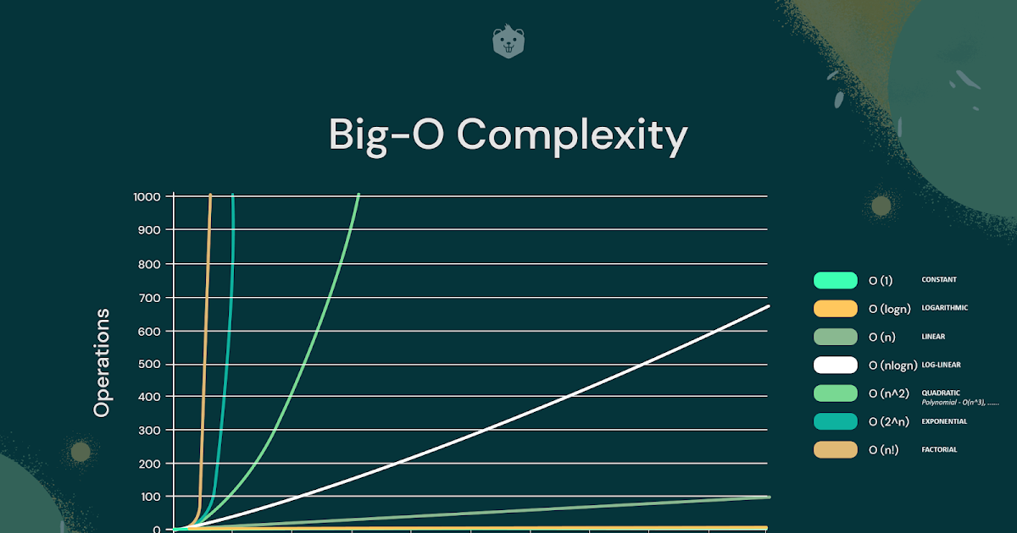

Slide 15

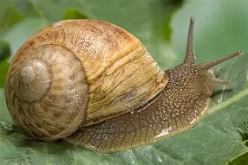
Fast
Slow
O(1) Constant
O(n log n) Log-linear
O(log n) Logarithmic
O (n^2) Quadratic
O(n) Linear
O (n1) Factorial

Slide 16
Time Complexity That was Used
Linear Time: O(n)
Logarithm Time: O(log n)
Quadratic Time: O(n^2)
Log-Linear: O(n log n)
Constant: O(1)

